Slide 1
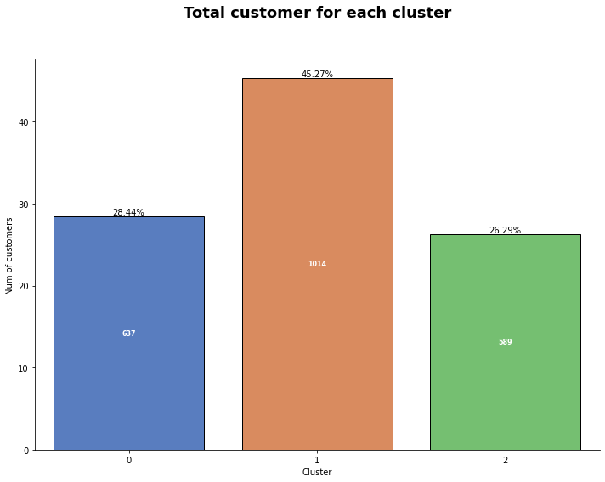
Customer Personality Analysis for Marketing Retargeting
There are three clusters produced, the three clusters can be defined as follows:
cluster 0 (637 customers or 28.44%) = high value customer, because the overall value is from the total spent, total transactions, but the recency value is small which means they rarely visit our platform.
cluster 1 (1014 customers or 45.27%) = low value customer, because the recency is quite high, they rarely shop and when they shop, the value spent is small.
cluster 2 (589 customers or 26.29%) = high value frequent customer, has a low recency value meaning it often visits our platform, often transacts in large enough amounts.
For more details, see jupyter notebook here

Slide 2
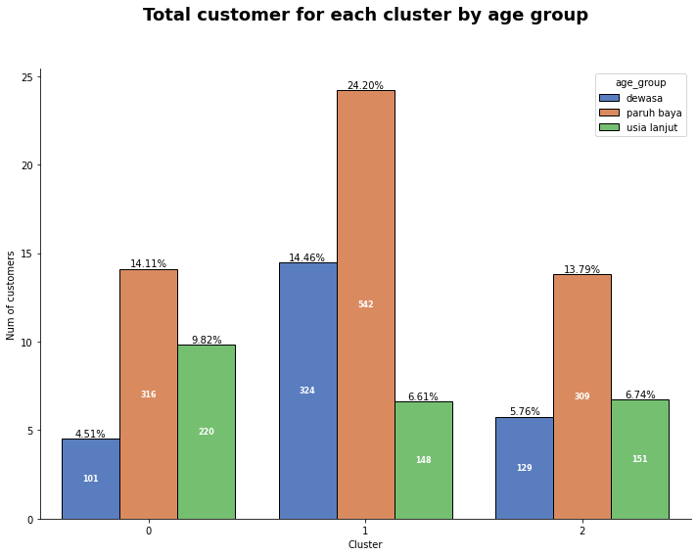
Customer Personality Analysis for Marketing Retargeting
In line with the EDA conducted in the previous stage, the middle age group dominated all clusters.
Some business recommendations that can help in marketing retargeting:
1. Create a membership program that offers prizes depending on the membership level of the customer. This membership level is determined from the total spent, total transactions, and recency values ​​as used in the RFM analysis method. Using a membership program will increase customer loyalty and encourage them to shop more often and more to catch up on the prizes on offer.
2. Focus on high value frequent customers to avoid churn. If necessary, give them the highest level of membership by always maintaining the quality of service so that they feel valued and feel comfortable shopping on our platform so that they can continue to have repeat orders.
For more details, see jupyter notebook here

Slide 3
Customer Personality Analysis for Marketing Retargeting
3. For high value customers who rarely visit our platform, provide special special discounts for them such as regular flash sales with special prices and give them notifications when flash sales are happening to increase the value of their visits with the hope that the total transactions and total spent will also increase .
4. For low value customers, special offers are also given in the form of discounts for items that have a low selling value to increase the value of visits to our platform. It is hoped that by increasing the value of these visits it can also increase the total value of transactions and total spent, although not as big as high value customers .
For more details, see jupyter notebook here

